Slide 1
CMAC 3990.200
Systems Administration and Operations
Fall 2025 – Week 8.1 – October 14th, 2025
Midterm Exam

Slide 2
CMAC 3990.200
Systems Administration and Operations
Fall 2025 – Week 8.2 – October 16th, 2025
Backups and Reviews
Virtualization and Containers

Slide 3

Objectives
Weekly Info
Reviews
Backups
Virtualization Overview
Survey of VM software
Container Overview
Assignment 8 Review
Group Project & Presentation Info

Slide 4

Weekly Info
A dream written down with a date becomes a goal. A goal broken down into steps becomes a plan. A plan backed by action makes your dreams come true. – Greg S. Reid
Office hours
  Available ~45 minutes before class
  On-campus most afternoons
    In classroom or in office – Ross 147
Attendance
Good of the class
Presentation Reminder!
  December 2nd!
Notes:
*Estimates

Slide 5

Assignment Reviews
Assignment 8 Review – Backups, VIP & VLAN, NFS
  Rsync installed and directories backed up
  Virtual IP interface bond0:0
  Virtual LAN interface bond0.187
  NFS Client Mount and NFS Server Export
  Updates and reboot
  Documentation!
Midterm Review
  250 Points
  Overall??

Slide 6
Assignment Info
Assignment 9 Info – Knowledge check
  Files & Folders
  Owners & groups
  Permissions
  Terms and info
  DNS Value lookups
Due Oct 24!

Slide 7
Assignment Info
Assignment 10 Review – Backups, VIP & VLAN, NFS
  Documentation
    Project Work Log
    Command Log
    Detailed Instructions
    Description of Functionality
  Configuration
    eth0, eth3, bond0, Virtual IP interface bond0:0
    Virtual LAN interface bond0.6, bond0.110, bond0.187
    NFS Client Mount and NFS Server Export
    Netdata
    New DNS records private1, private2, ipv6
    Tiger VNC
    Compile Apache from Source
    Backup script and cron job
    Updates and reboot
    Check script!
Due Oct 31?
Details TBD…

Slide 8
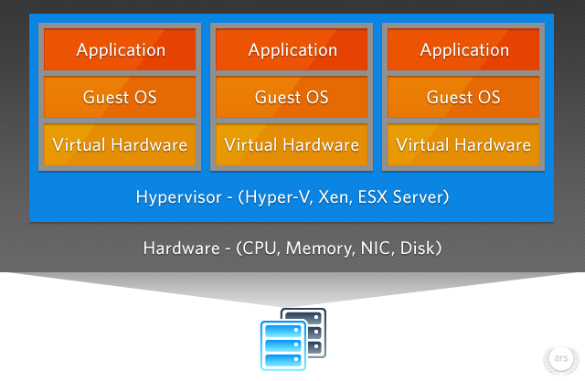
Virtualization
“Making something look like something else”
The abstraction of resources
  Can be achieved through software, hardware, or both
Virtualization offers many benefits
  More environmentally friendly!
    Less power usage, lower carbon footprint
  Better utilization of resources
    Less wasted CPU cycles, RAM, disk space
  Cost savings
    Fewer hardware components to purchase
  Reduces downtimes
    Guest migrations
Let’s Get
Physical Virtual!
Notes:
Physical (Olivia Newton-John song) (originally "Let's Get Physical") was written by Terry Shaddick and Newton-John's longtime friend Steve Kipner

Slide 9
Virtualization
“Making something look like something else”
The abstraction of resources
  Can be achieved through software, hardware, or both
Virtualization offers many benefits
  Provides mechanisms for cloud computing
    Documentation, procedures, and scripting can be transferred from
    virtual machine configuration to a cloud configuration
  Increased cross-platform support
    Multiple OS support, regardless of platform
  Ideal testing environments
    Easily reproduced machines, configured to known state
  Improved growth management
    Easier to add machines to your virtual environment
    than your physical environment
Let’s Get
Physical Virtual!

Slide 10
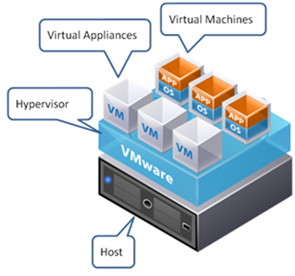
Virtualization
Concepts, terms, and definitions
  Guest OS – The operating system that is virtualized; the virtual machine!
  Host OS – The physical hardware and OS which is hosting the guests
  Hypervisor – Hardware and/or software that provides a CPU-like interface to VM’s
    Sometimes called a Virtual Machine Monitor (VMM)
  Hardware emulation – Software that is used to emulate the CPU’s instruction set
    Typically slower, due to amount of processing necessary
  Full Virtualization – Extended instruction set in host CPU’s that allow
  direct hardware interaction with a guest machine.
    Bare-metal or native virtualization
    Hardware seen by the guest is functionally similar to the host hardware
    Intel VT & AMD-V CPU specifications
    Supported by KVM, Xen, VMWare, VirtualBox, Hyper-V, and more

Slide 11
Virtualization
Concepts, terms, and definitions
  Paravirtualization – Software virtualization
    Requires kernel modification of guest VM’s
      Guest OS must be configured to run on the hypervisor
      Main disadvantage
    Can minimize overhead and increase system performance
      Underutilized systems can be better optimized
    Typically faster than full virtualization
  Containerization – Software extensions
    Contain applications and dependencies to isolated processes
    Control resource allocation
    Deployment framework provides consistency, version control, and ease of use
    Kind of like a VM for an application…

Slide 12
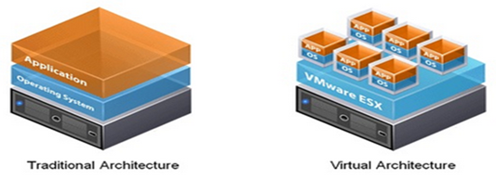
Virtualization
Implementations
  Hyper-V – Microsoft
    Requires hardware that supports full virtualization
    Runs on Windows OS’s
  Kernel-Based Virtual Machine (KVM)
    First official Linux Kernel virtualization implementation
    Requires hardware that supports full virtualization
  QEMU
    Allows for machine emulation
      Run ARM architecture in a guest on an x86 platform
    Used by many other virtualization projects
    Mature, stable, well tested
  Xen
    Supports both full and paravirtualization
    High performance

Slide 13
Virtualization
Implementations
  VirtualBox
    Relatively easy to set up and use
    Cross-platform support
    Free for personal or educational use
    Additional enterprise features, support, functionality with commercial licensing
  User-Mode Linux (UML)
    Virtualization implemented in user space
      Increased security
      Decreased performance
  VMWare
    Oldest and most well known commercial virtualization platform
    Cross-platform support
    High performance
    Free and commercial versions available

Slide 14

Virtualization
Example KVM Guest Creation
  KVM Prefers CPU VM-Extensions!
    Can run without extensions, using QEMU-based emulation, with lower performance
  Install necessary packages to support KVM
    kvm virt-manager libvirt virt-install qemu-kvm xauth dejavu-lgc-sans-fonts
  Enable IP forwarding!
    Your hypervisor will need to forward packets on behalf of the guests!
    You can this add to the /etc/sysctl.conf file to enable forwarding for IPv4 & IPv6 respectively
      net.ipv4.ip_forward = 1
      net.ipv6.conf.all.forwarding = 1
    Load in settings of /etc/sysctl.conf file
      sysctl –p
    Configure firewall masquerading (NAT)
      sudo firewall-cmd --add-masquerade --permanent
      sudo firewall-cmd --reload
Example!

Slide 15
Virtualization
Example KVM Guest Creation
  Create a network bridge device (br0)
    A bridge device is a software-switch that allows communication from the guest
    A bridge device can create a switch out of different physical interfaces
Example!
/etc/sysconfig/ifcfg-br0
TYPE=Bridge
NAME=bridge-br0
DEVICE=br0
STP=yes
BRIDGING_OPTS=priority=32768
PROXY_METHOD=none
BROWSER_ONLY=no
BOOTPROTO=none
DEFROUTE=yes
ONBOOT=yes
IPADDR=10.20.30.1
PREFIX=23
ZONE=public
/etc/sysconfig/ifcfg-enp1s0
TYPE=Ethernet
NAME=bridge0-port1
DEVICE=enp1s0
ONBOOT=yes
BRIDGE=br0

Slide 16
Virtualization
Example KVM Guest Creation
  Android x86 9.0 r2 i686/x86
  virt-install -n android90 --vcpus=2 --cpuset=auto -f /android/android90.img -s 5 -r 4096 --nonsparse -w bridge=virbr0 --vnc --accelerate -c /android/android-x86-9.0-r2.iso --os-type=android-x86-9.0 --noautoconsole
  -n NAME
    Name of the new guest virtual machine instance.
  --vcpus=VCPUS
    Number of virtual cpus to configure for the guest.
  --cpuset=CPUSET
    Set which physical cpus the guest can use.
  -f <path_to_file>
    Path to VM disk storage location
  -s SIZE
    Disk space to allocate for guest instance in gigabytes.
Example!

Slide 17
Virtualization
Example KVM Guest Creation
  -r MEMORY
    Memory to allocate for guest instance in megabytes.
  --nonsparse
    Fully allocate disk space to guest (do not thin provision)
  -w NETWORK
    Connect the guest to the host network.
  --vnc
    Setup a virtual console in the guest and export it as a VNC server in the host.
  --accelerate
    Prefer KVM or KQEMU (in that order) if installing a QEMU guest.
  -c CDROM
    File or device use as a virtual CD-ROM device for fully virtualized guests.
  --os-type=OS_TYPE
    Optimize the guest configuration for a type of operating system.
  --noautoconsole
    Don’t automatically try to connect to the guest console.
Don’t forget about man pages!

Slide 18
Virtualization
Example KVM Guest Creation
  virsh autostart android90
    Enable our guest VM to automatically start when the Host is booted
  virsh list --all
    Show all currently configured VM’s
  Find VNC port that the new VM is listening on…
    Use ps command to find PID of new VM
      ps aux | grep android90 | grep -v grep | awk '{print $2}'
    Use netstat command to find port that process is listening on
      netstat -anlp | grep <PID> | awk '{print $4}'
    One liner to do both:
      netstat -anlpt | grep $(ps aux | grep android90 | grep -v grep | awk '{print $2}') | awk '{print $4}'
    Use a custom script to do this for you!
      Or don’t. Whatever. It’s fine.
Don’t forget about man pages!

Slide 19
Virtualization
Example KVM Guest Creation
  Connect via VNC & Install Android OS!
    Create a new bootable partition using all available space, and tell the installation to use it! Reformat as ext4…
  Reboot
    This might actually power off the VM, so you have to restart it
  Reconnect via VNC and finish configuration and use!
    Finally I can play Clash of Clans on my PC!
      Clash of Clans is horrible don’t play that game.
  Different versions of Android and different hypervisors will have different results…
    32 vs 64 bit
    Specific Android version
    Specific hypervisor platform
    Specific hypervisor version

Slide 20
Virtualization
Example VirtualBox Guest Installation
  Lets just do a quick VirtualBox installation example…
  There are many different hypervisor platforms
    They are all fairly similar in implementation
After creating, don’t forget to destroy!
  virsh destroy android90 (poweroff)
  virsh undefined android90 (delete config)
  rm -rf /android/android90.img (delete install image)

Slide 21

Linux Commands
cp
ifdown
ifup
virsh
virsh list --all
systemctl
wget
virt-install
ps
dnf
docker
firewall-cmd
netstat
chroot

Slide 22

Key Terms and Items
VM Implementations
chroot
Virtualization
  Benefits
Host
Guest
Hypervisor
Hardware emulation
Full virtualization
Paravirtualization
Containers
  Benefits

Slide 23
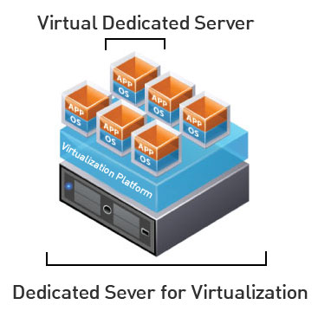
Virtual Machines
VM Info:
  IP Address: 147.64.243.1##/23 (01-15) – bond0
  Hostname: ecsc425-1##.cs.edinboro.edu (01-15)
  Alias: 41##.megastuff.biz (01-15)
  Samba: \\147.64.243.1##\ (01-15)
  Interfaces:
    eth0, eth1, eth2, eth3
  Additional IP’s:
    bond0:0 – 147.64.243.50+##/23
    bond0.6 – fd06:1234:5678:beef:1##::1/64
    bond0.110 – 10.10.1##.1/16
    bond0.187 – 10.0.187.##/24
    bond1 – 192.168.1.1##/24
    bond1:0 – 192.168.0.2##/24
    bond1.425 – 192.168.1##.25/19

Slide 24

For Next Week
“A place for everything, everything in its place.” –Benjamin Franklin
Textbook:
  Chapter 24: Virtualization
  Chapter 25: Containers
  Chapter 31: Methodology, Policy, & Politics…
Done a little early today
  Work time/open time.
Next week topics
  Documentation!
  Change management!
  Other network services!
  Work time!

